Slide 1
Vegetation Classification vs. Current Seedling Community Composition
Christiana Quinata
EEB698 Final Presentation

Slide 2
Baseline Survey and Long-term Monitoring Plan
(1) results from the ecosystem baseline survey
(2) potential treatment units based on environmental conditions,
(3) site parameters for native limestone forest plant species,
(4) non-native species to be controlled or eradicated,
(5) locations for reference sites.

Slide 3
Introduction
Does the current vegetation classification correctly classify seedling and saplings?
Importance: What type of regeneration is occurring within the different vegetation classifications

Slide 4
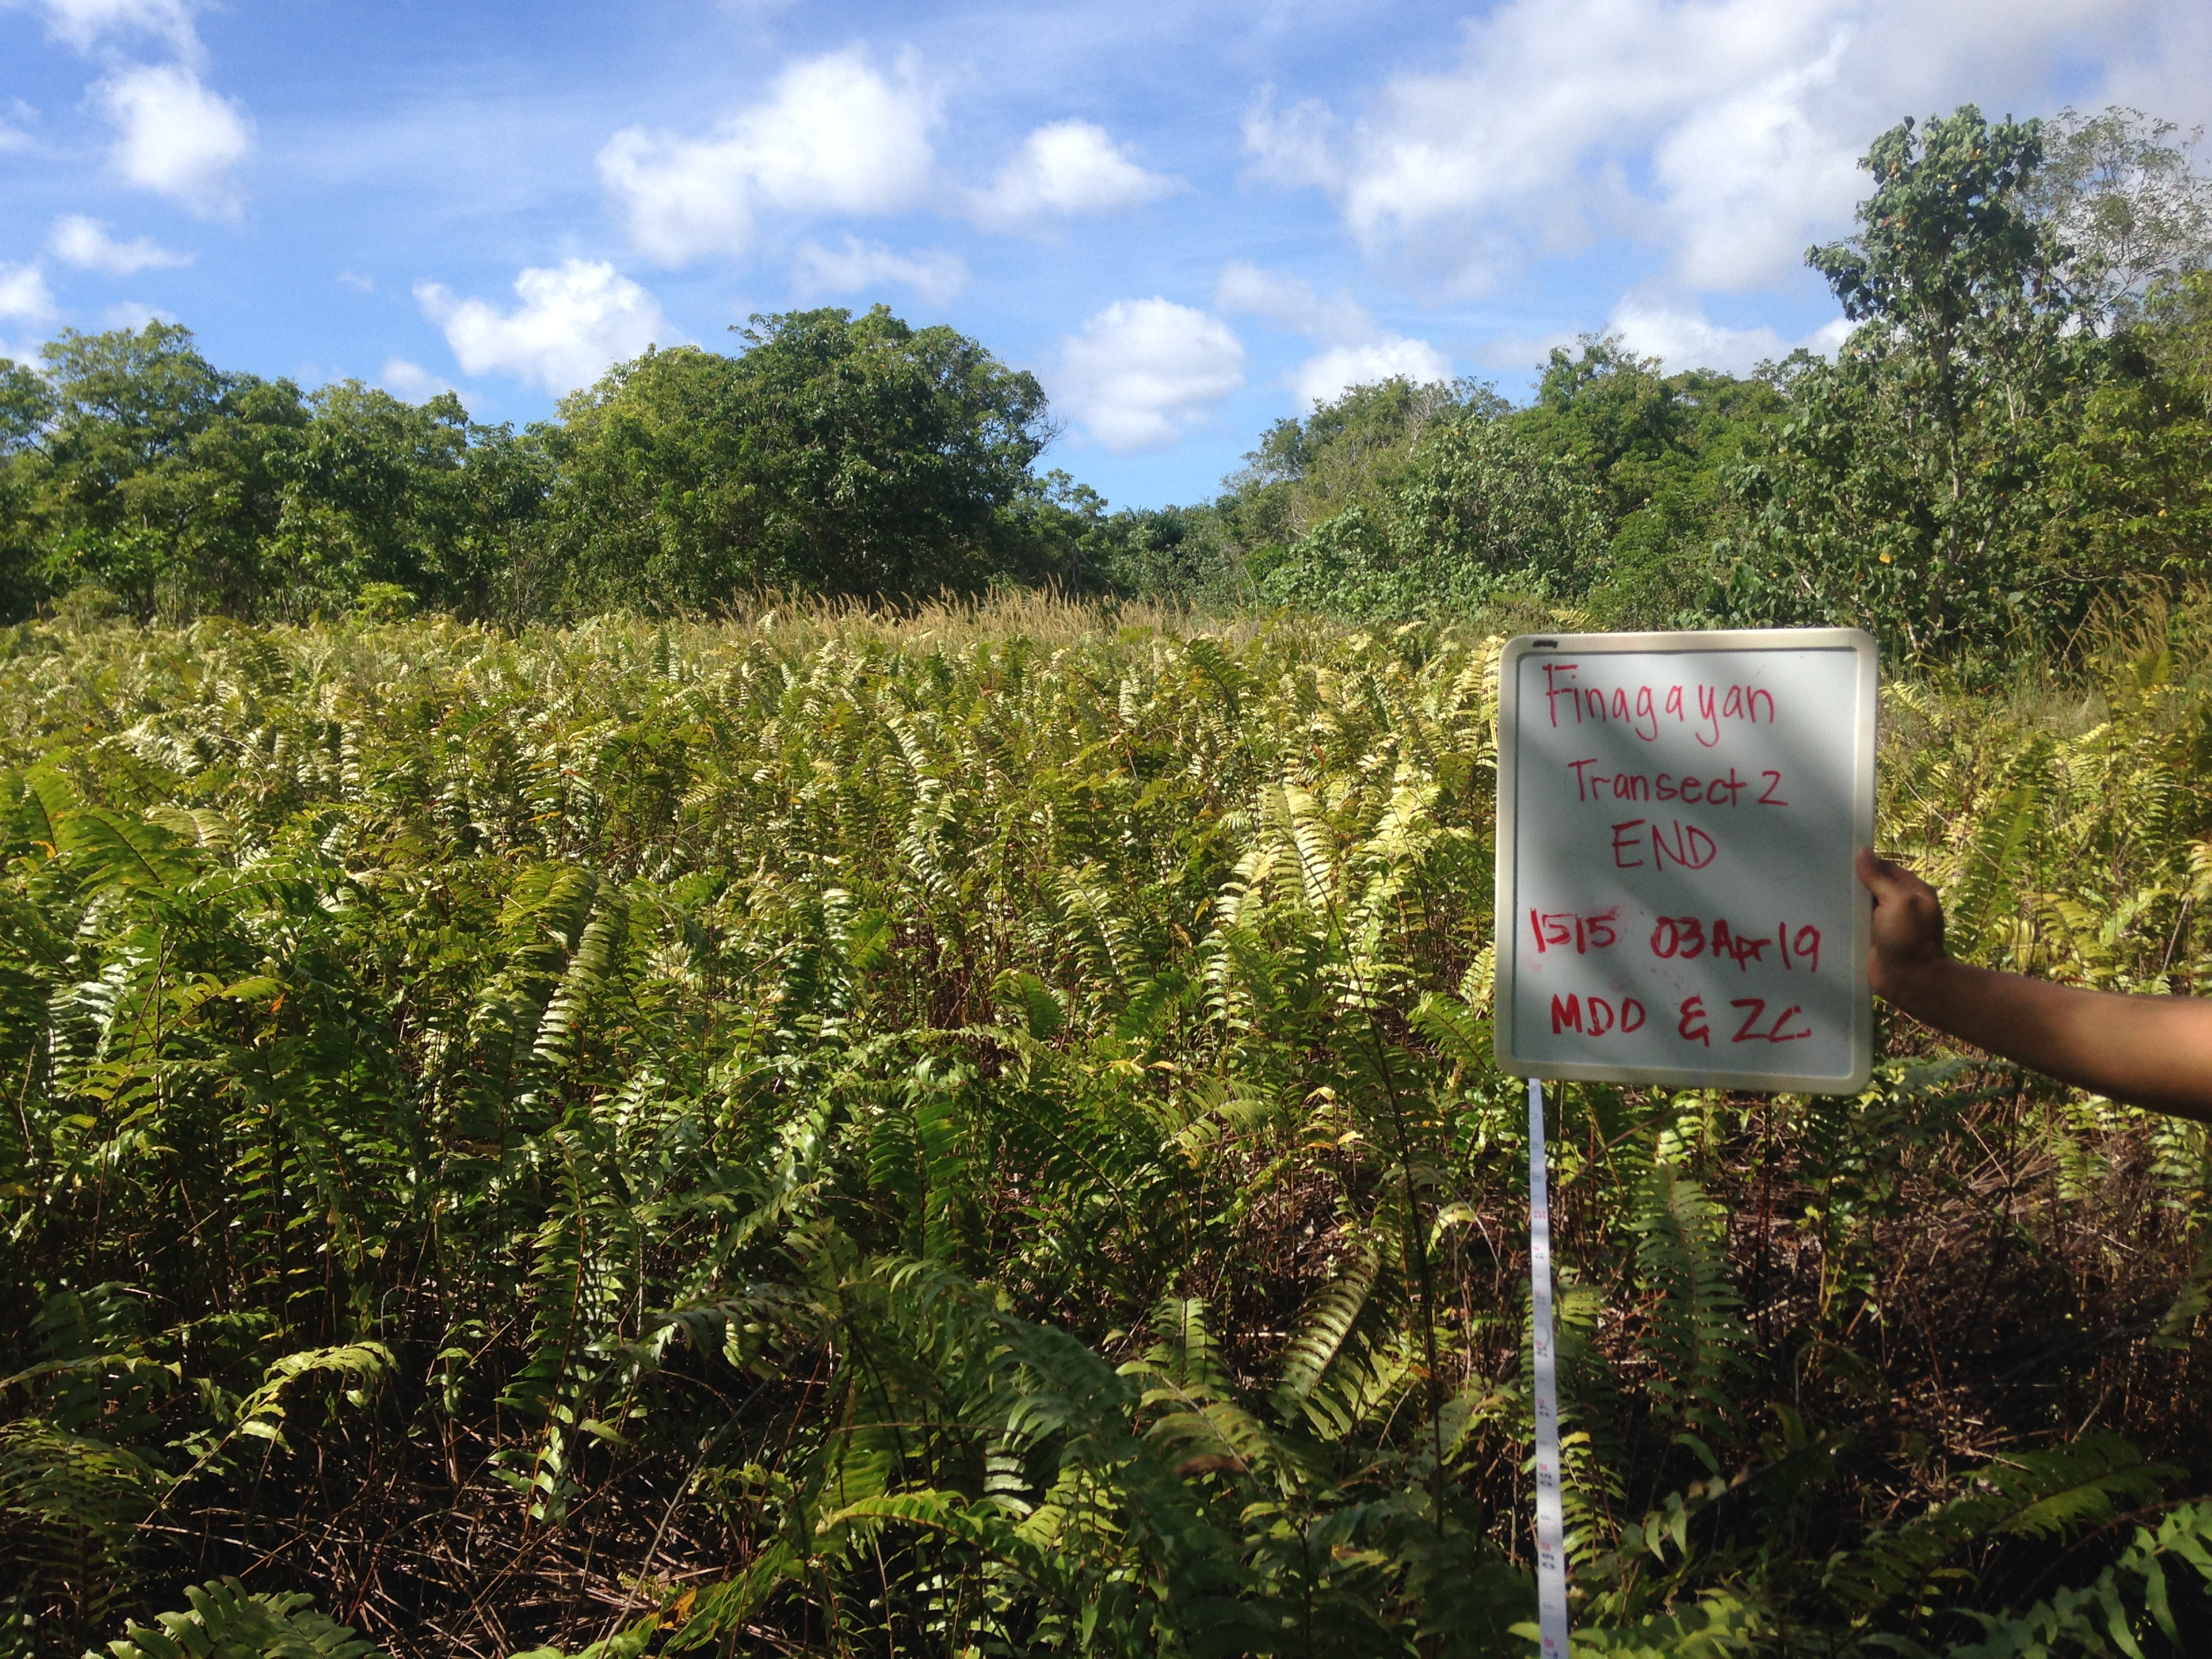
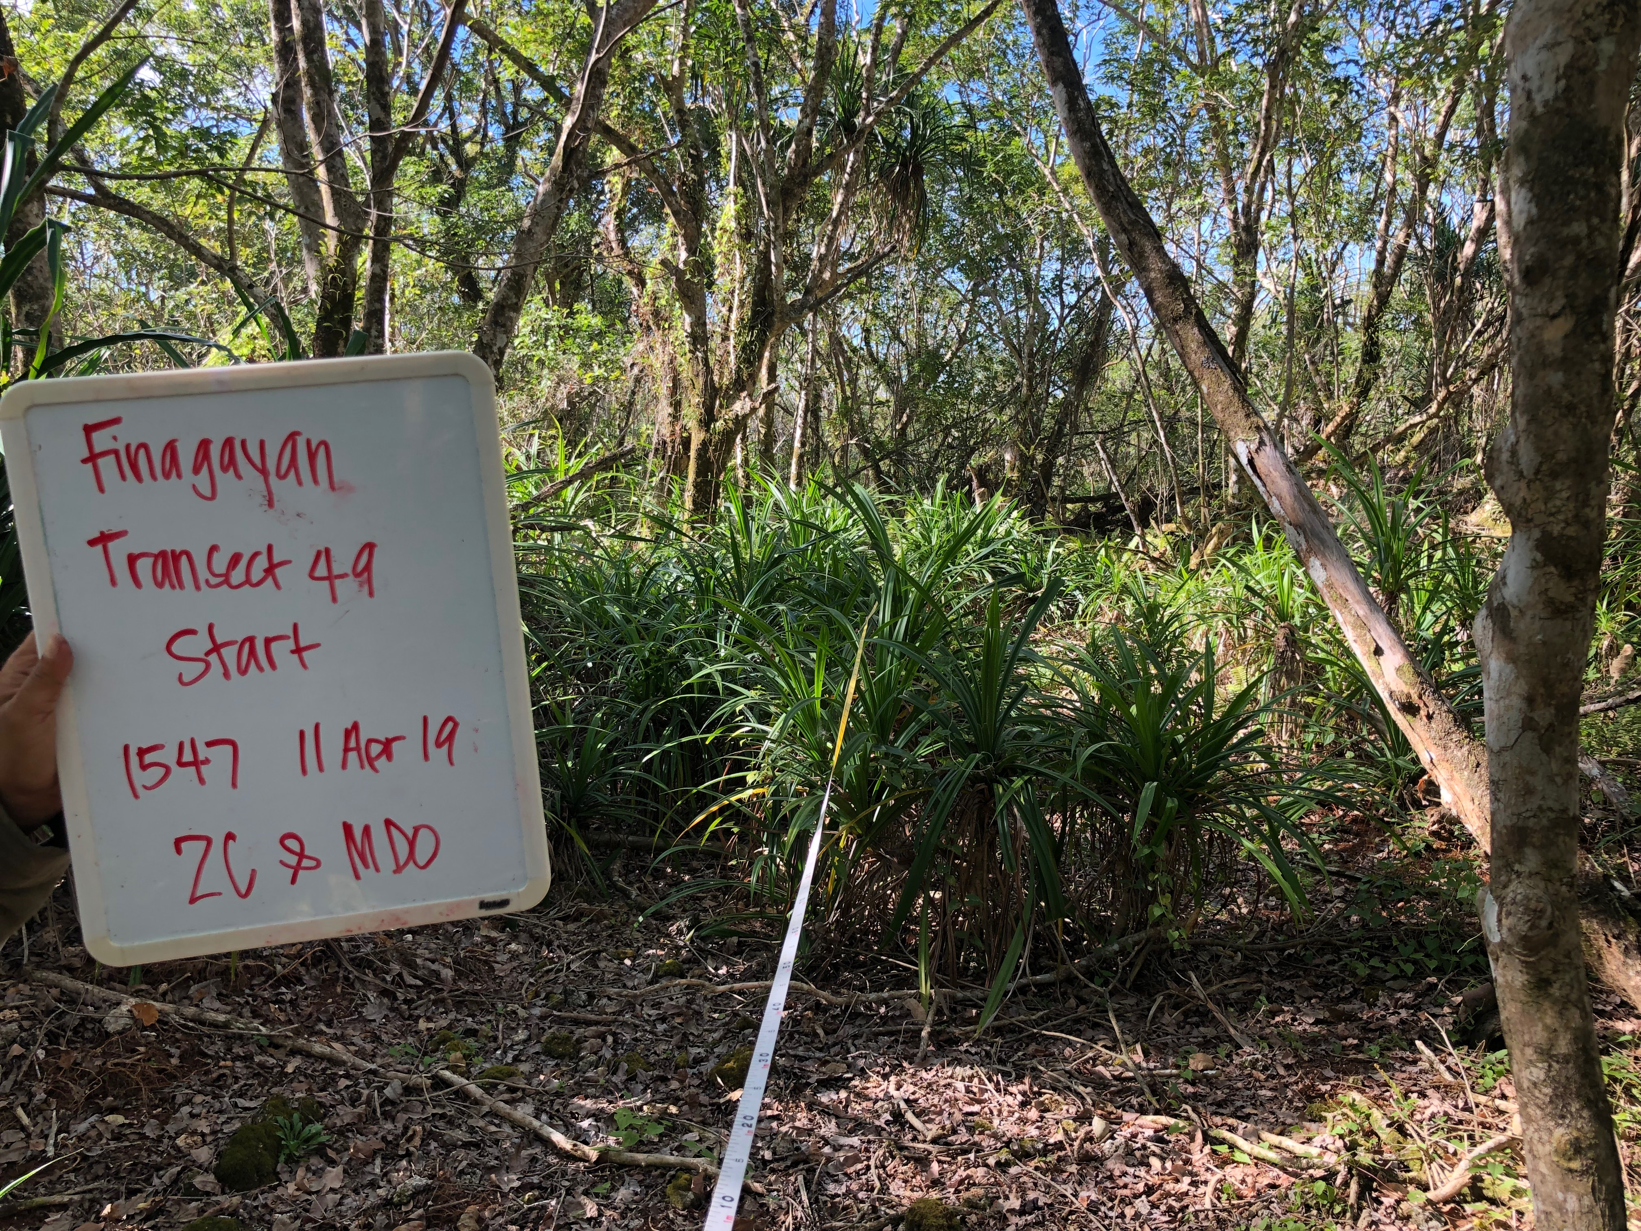
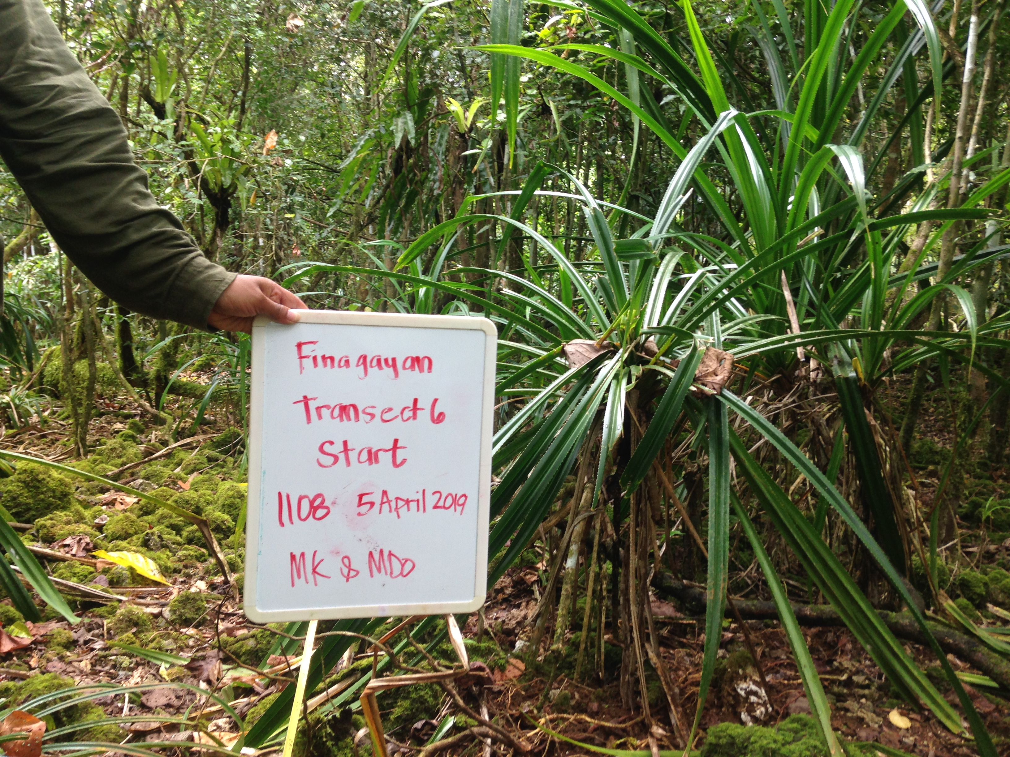
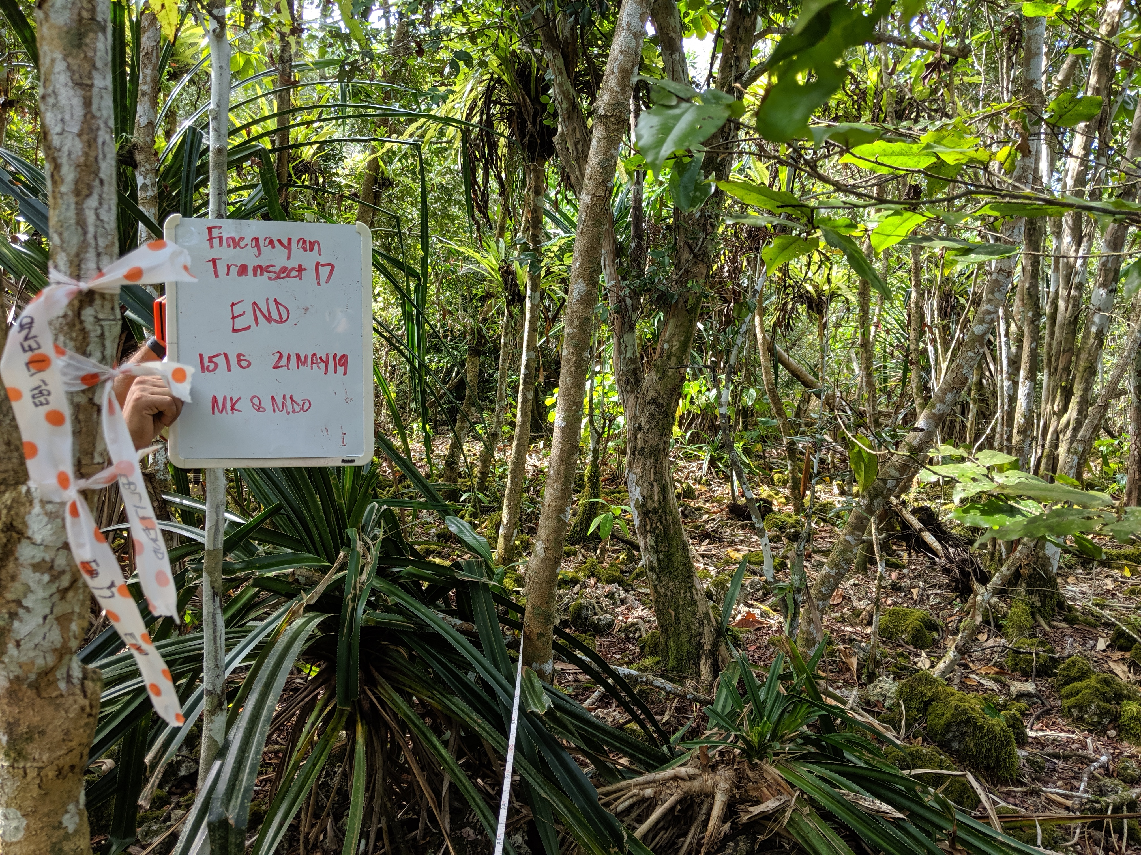
Vegetation Types
Notes:
Challenges of using other types of abiotic conditions to classify vegetation/area types, abiotic conditions generally the same, remnant native species composition is key.
Abiotic conditions will be used later but for now community composition will be used to determine how to group areas by vegetation communities.

Slide 5
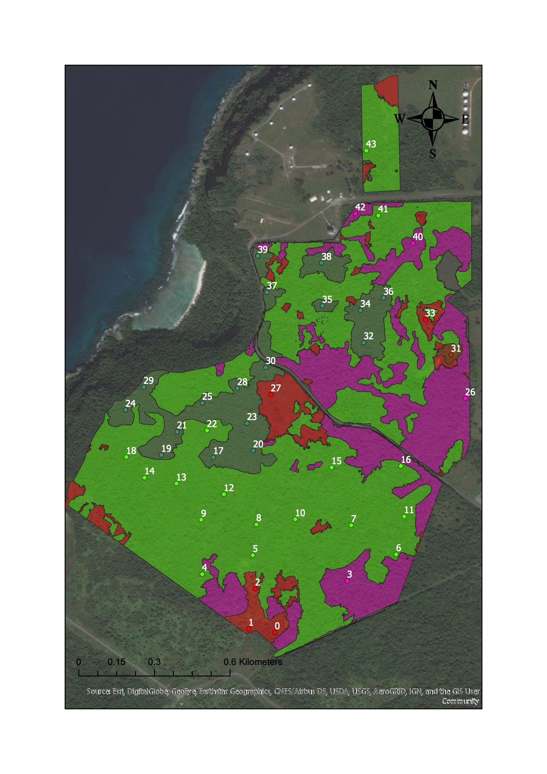
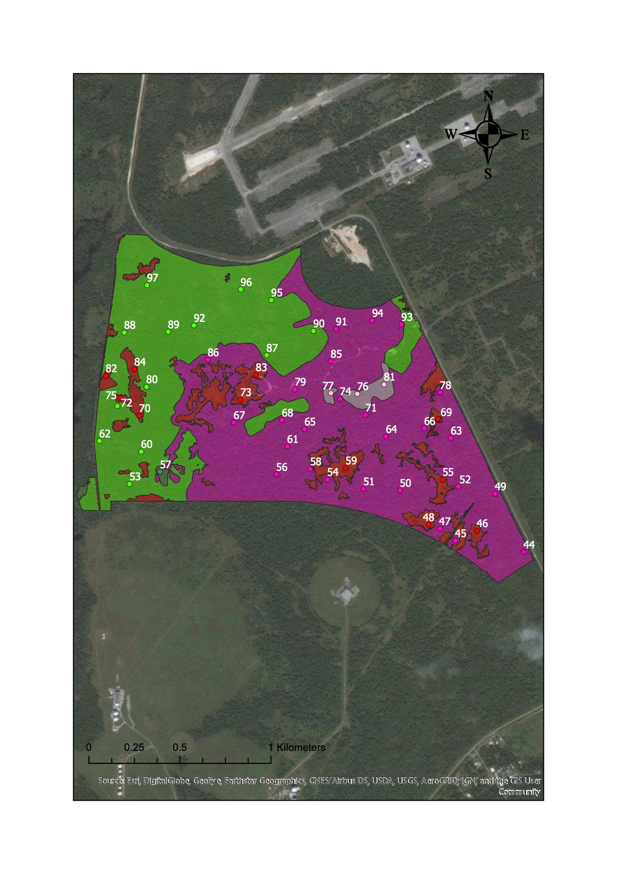
Methods
Vegetation Transect Survey
Overstory
Understory quadrat
Understory belt
Additional species
Vine cover
Understory belt
25 meter transect, Seedling and sapling count
98 transects

Slide 6
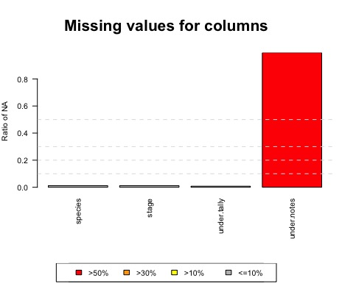
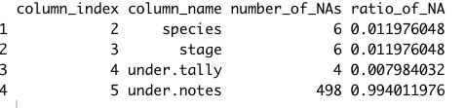
Finding NA’s
Package varhandle
Function Inspect.na

Slide 7
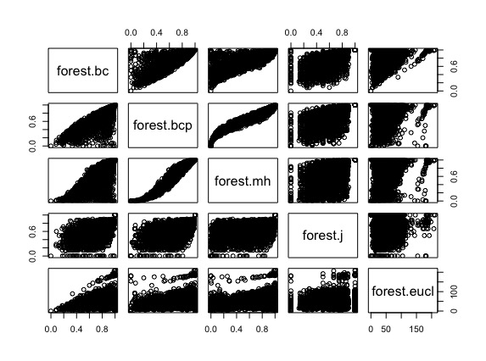
Analysis:NMDS
Non-linear Multidimensional Scaling (NMDS)
Marasita horn
Clustering

Slide 8
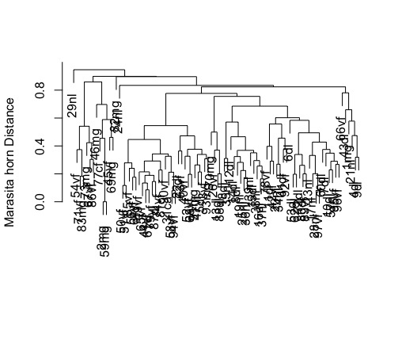
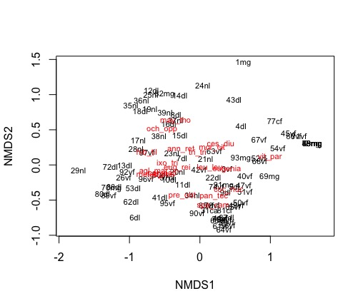
Results
Notes:
Stress of the model shows if it fits well with data Stress of 0.2 is fair, Stress was 0.17

Slide 9
MDS3
forest.mds3 <- metaMDS(forest.mh,k=3,distance='horn',autotransform=F)
Stress: 0.104 = ok fit, 0.05 would be better

Slide 10
Discussion
Current vegetation classification is not representative of seedling/sapling composition
Invasive species (i.e. ungulates) have impact on forest recruitment, in turn further altering regeneration of forests on Guam.

Slide 11
Further Application
Additional species list
Incorporate overstory in species composition per transect
Notes:
Identify most prevalent invasive species
Driver for degraded forest types
Environmental variables – light, humidity between vegetation types to further define these vegetation types.
Conduct multivariate analysis comparing these plant communities with reference site plant communities.
Potential metric for reference site success criteria

Slide 12
Acknowledgements
Field Crew
Martin Kastner (Project Lead)
Zia Crytser
Joanna
Adeline
Data Wrangler
- McKayla Spencer

